Slide 1
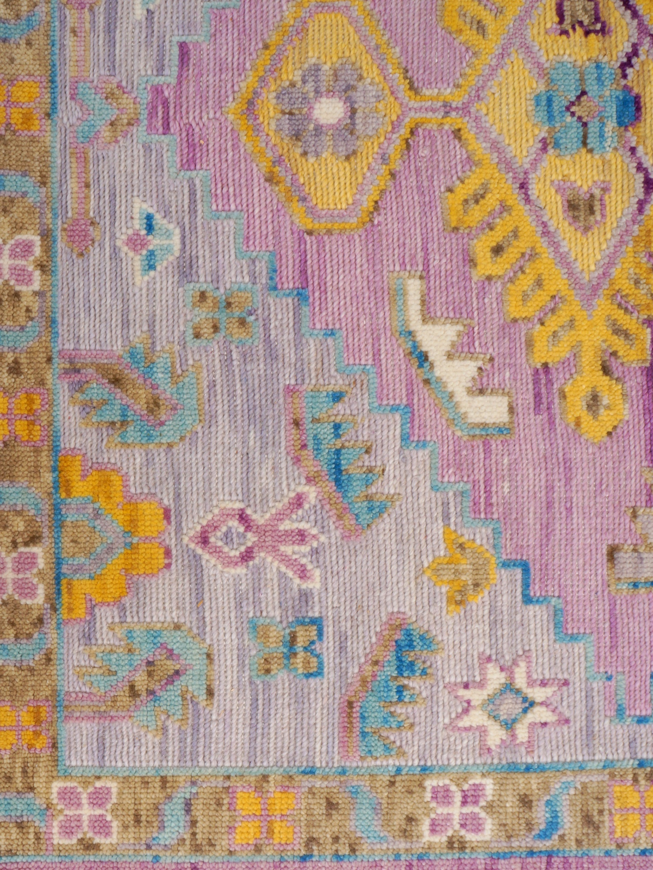
KABIR CARPET INTERNATIONAL
SINCE|RUGS|1970
ISSUE #01 / FALL 2021
CATALOGUE SUPPLEMENT

Slide 2
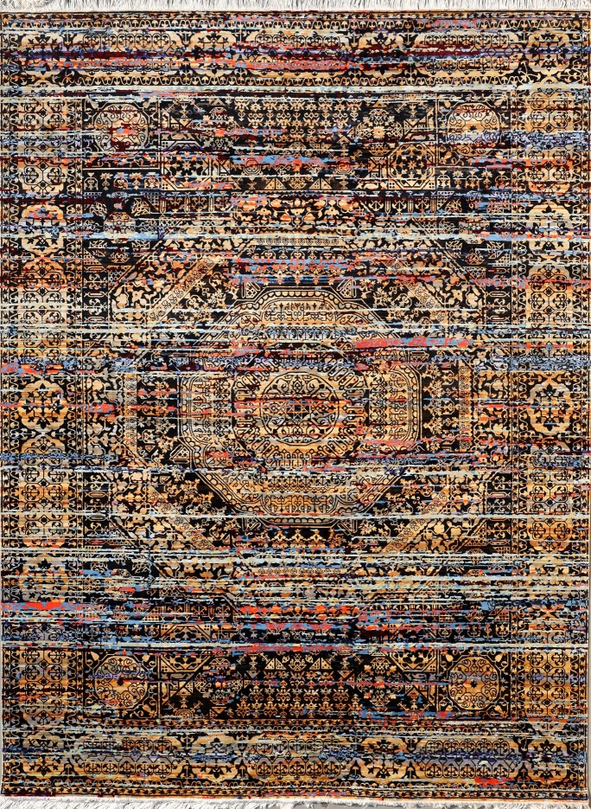
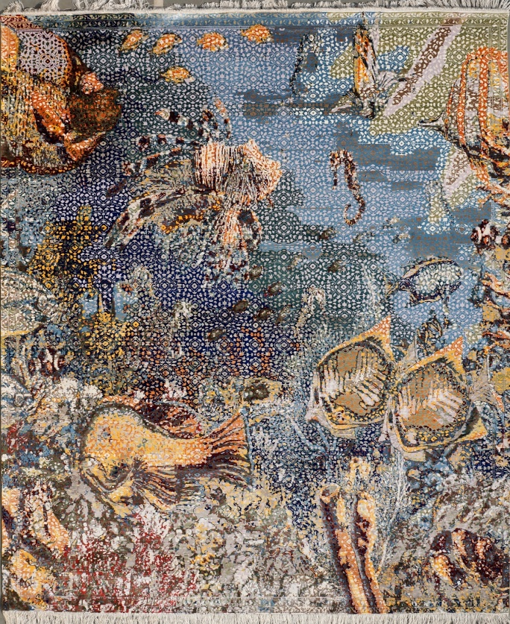
Trend : Mankind
MAMLOOK
Construction Hand-Knotted
Material s 100% Pure Silk
Origin India
• Elegantly nuanced palette
featuring soothing the silk in
dyied tones.
• Art mamlook design that are
rendered with the softened
contours of an artisanal hand
and it present like aquarium
and art design.
• Indian hand-knotted
construction in a luxurious silk
blend.
MAMLOOK 1 BLACK/MULTY
• One of kind rug.
Available in 9x12 size.
MAMLOOK EQUARIUM

Slide 3
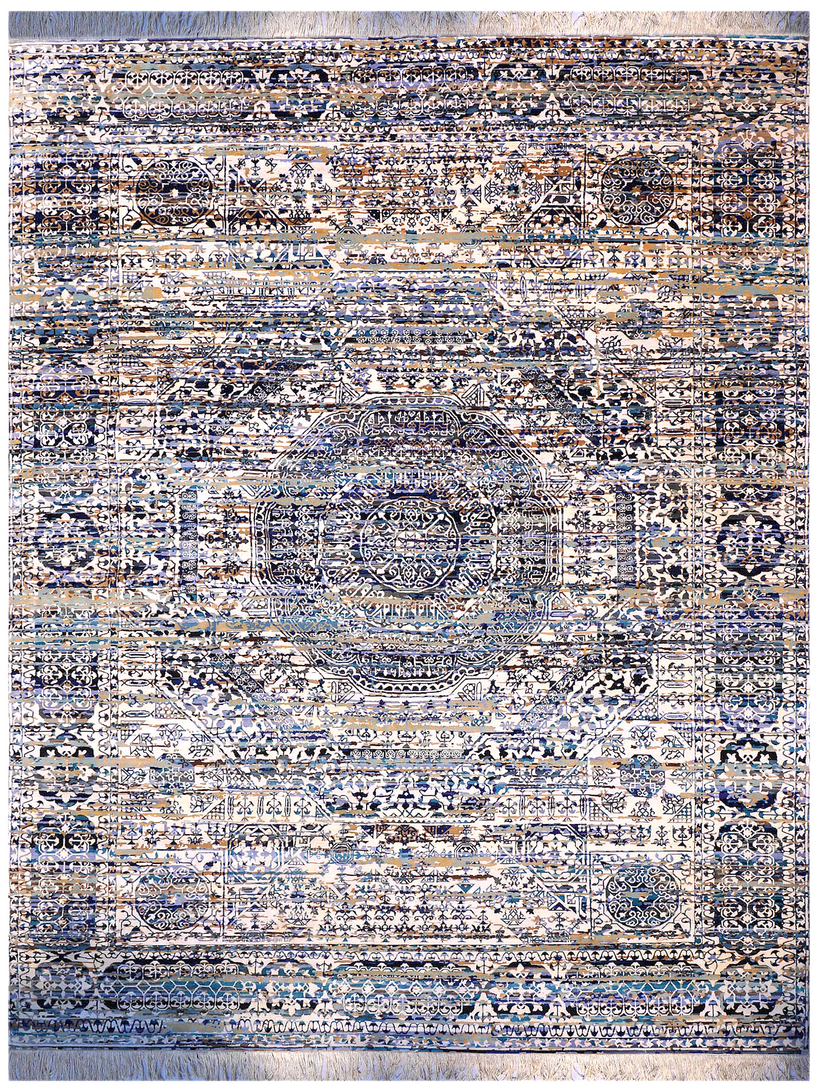
MAMLOOK 1 BLUE/MULTY

Slide 4
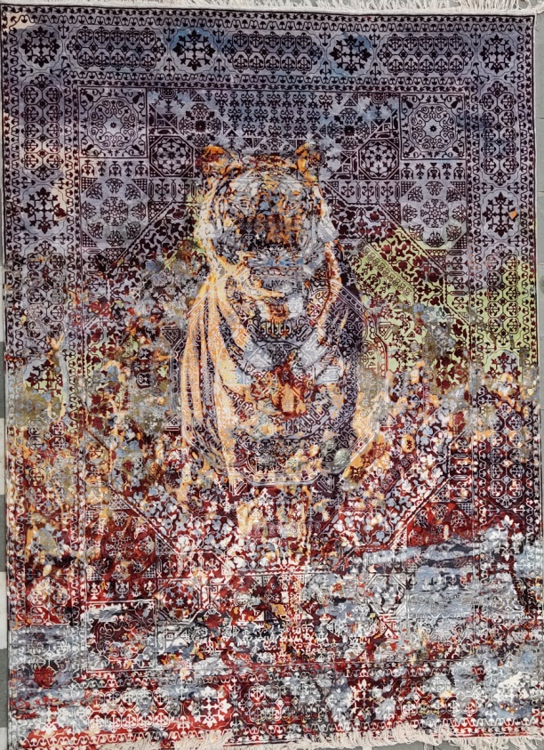
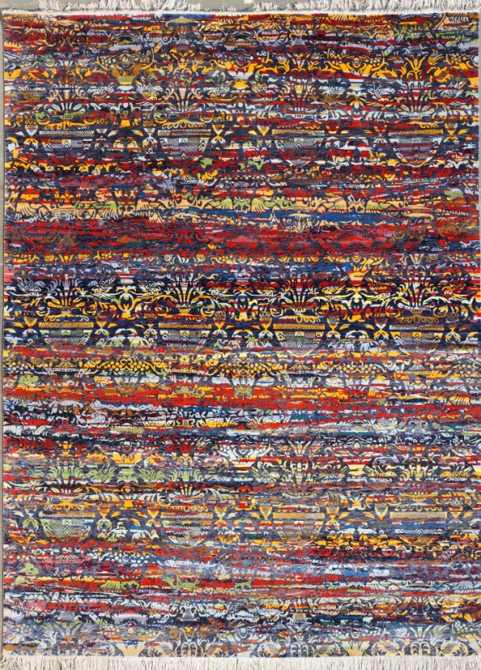
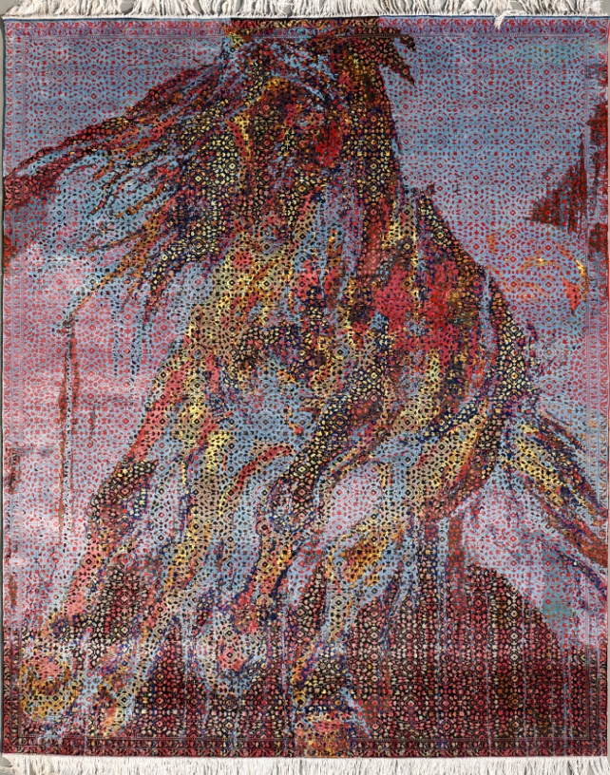
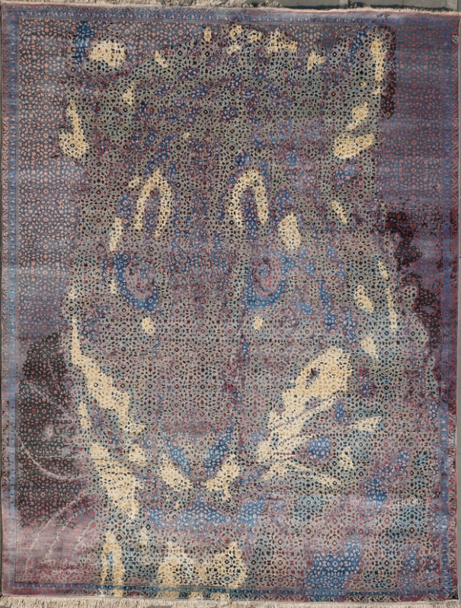
MAMLOOK TIGER
PARADISE-01
MAMLOOK HORSE
MAMLOOK LEOPARD

Slide 5
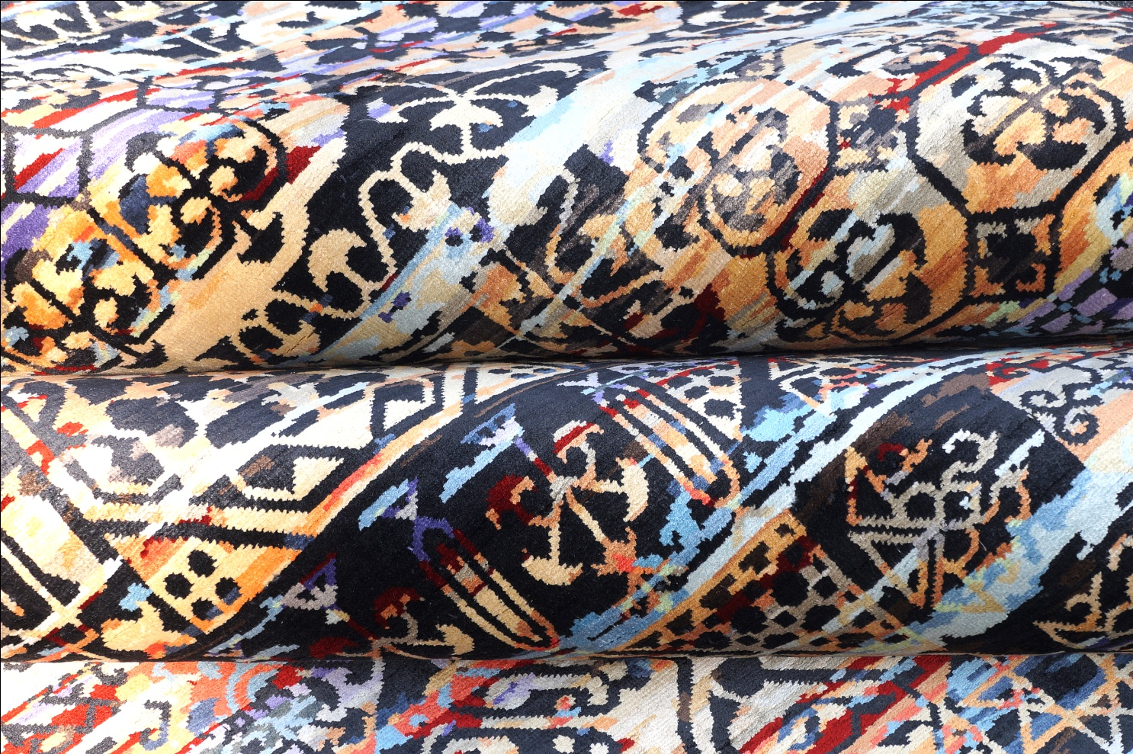
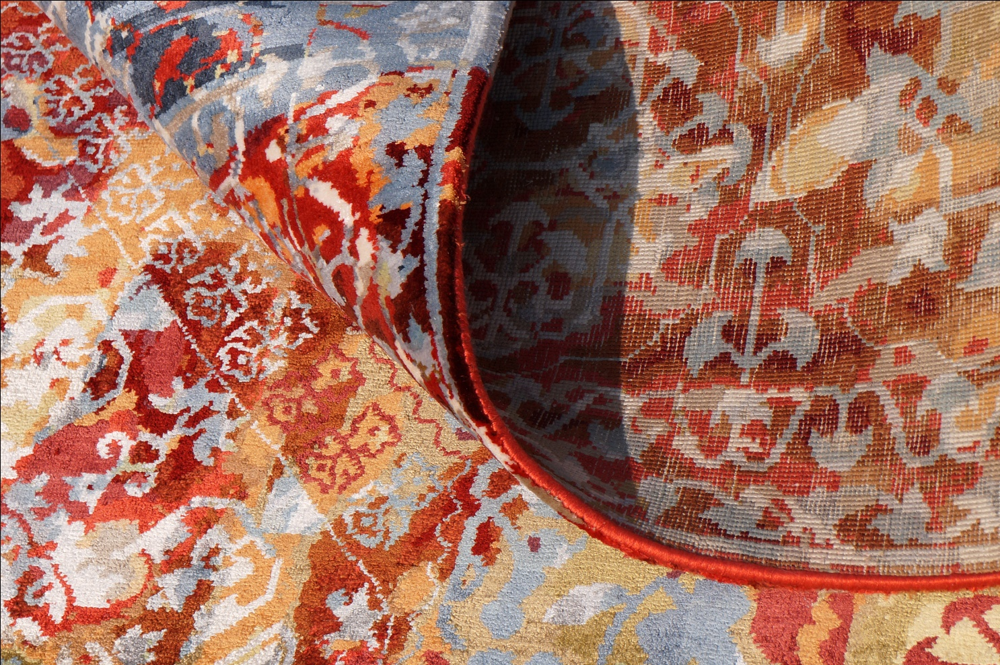

Slide 6
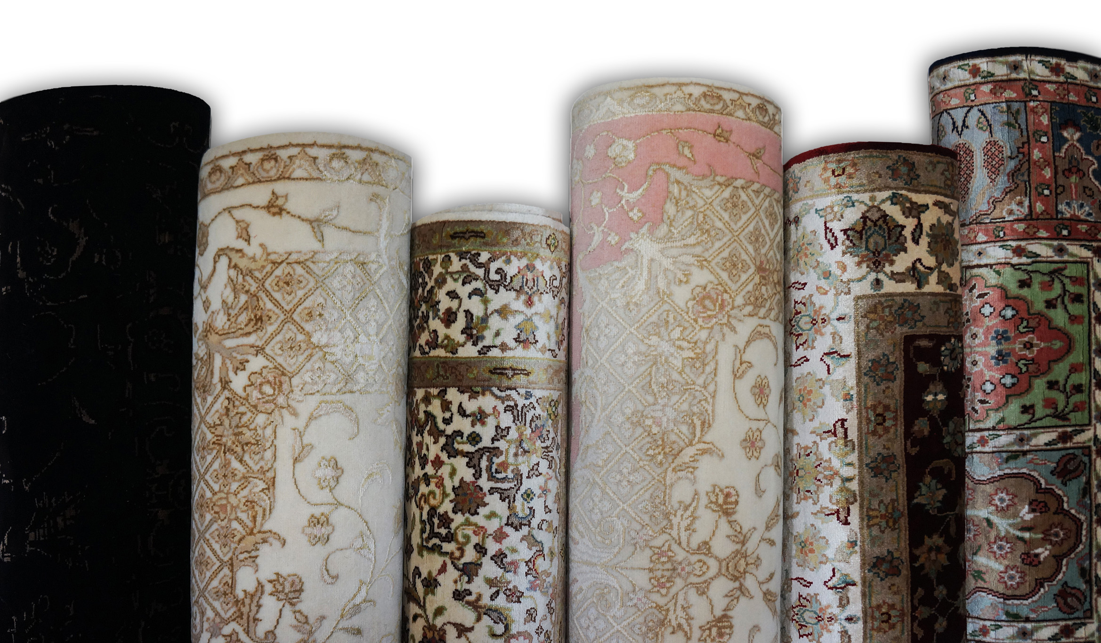

Slide 7
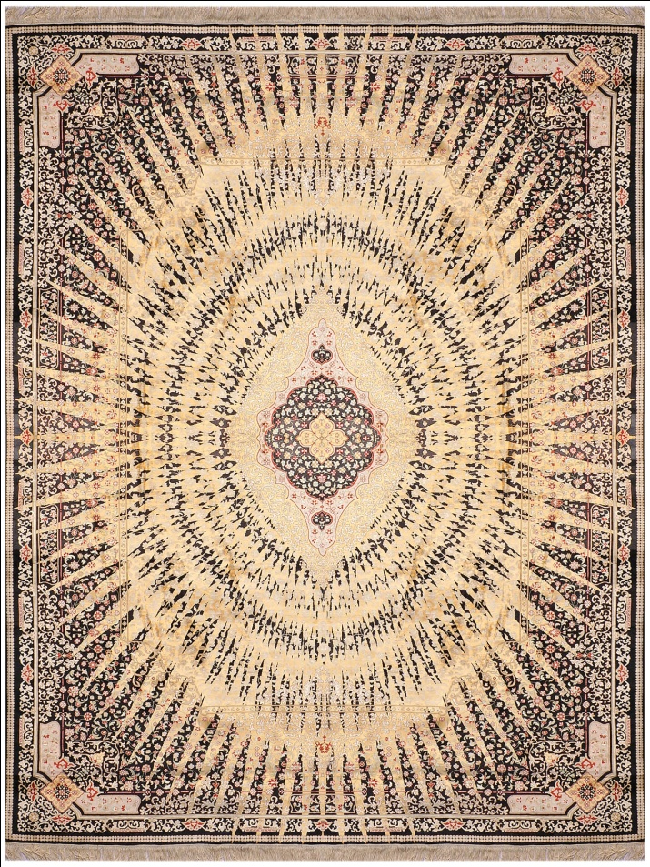
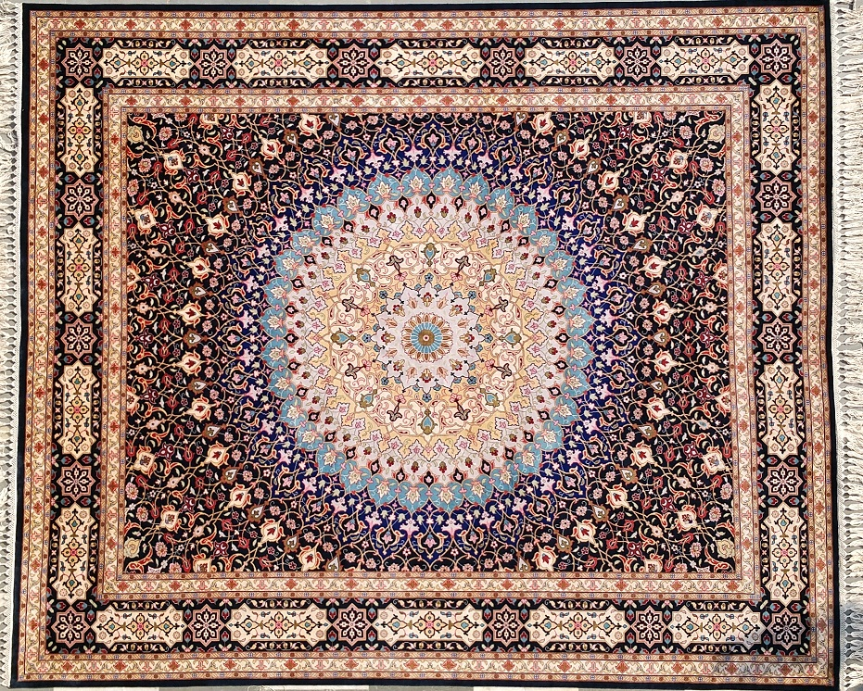
Trend : Mankind
SILKO
Construction Hand-Knotted
Material s 100% Silk on Silk
Origin India
• A gorgeous palatte in a golden
shade and black tone and multy
colour tone.
• Intricate and traditional Persion
design motifs rendered beautifully
in hand – knotted elegance.
• Medium pile, hand-knotted pure silk
construction featuring an all dying
coloured weving technique that
creates the shade of the antique
carpet.
SUNFLOWER
• All size available and custome
size also and all work done in
house campus only.
Size we make like ;
5.0x8.0,6.0x9.0,
8.0x10.0,9.0x12.0,
10.0x14.0,12.0x15.0
GUMBAJ

Slide 8
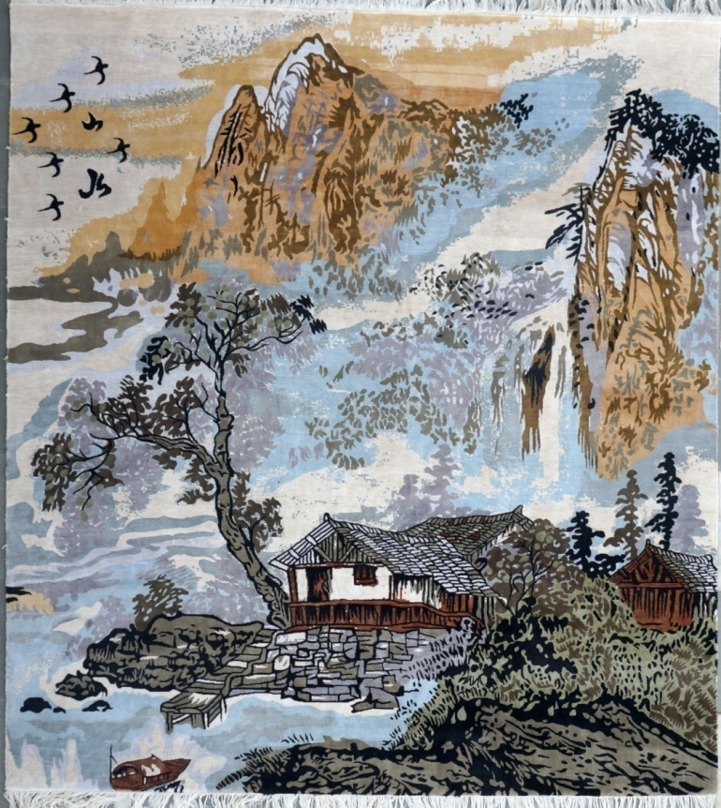
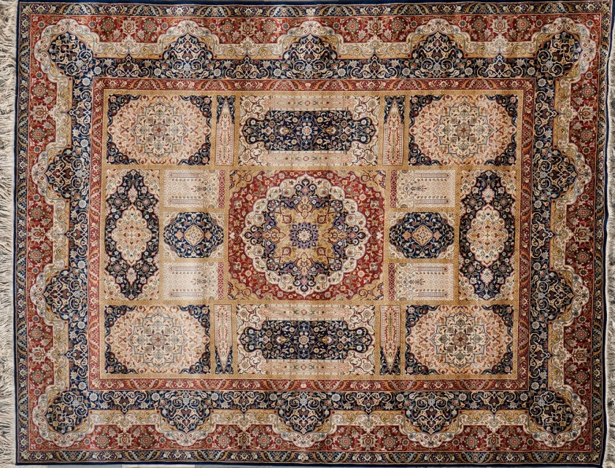
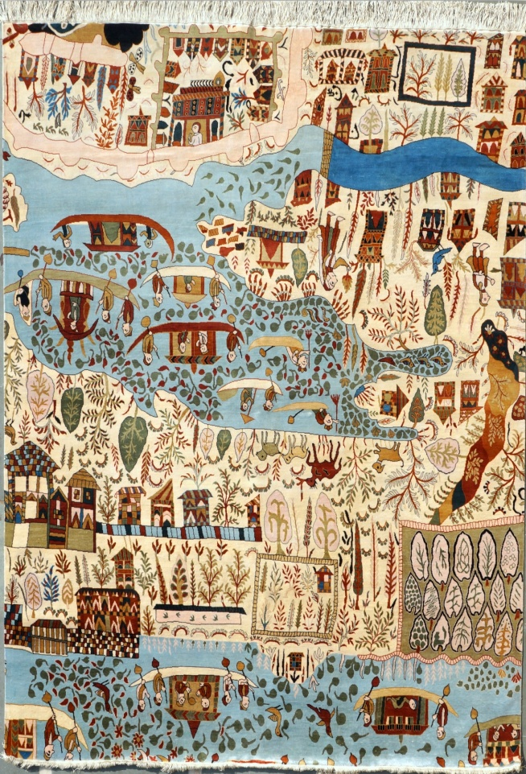
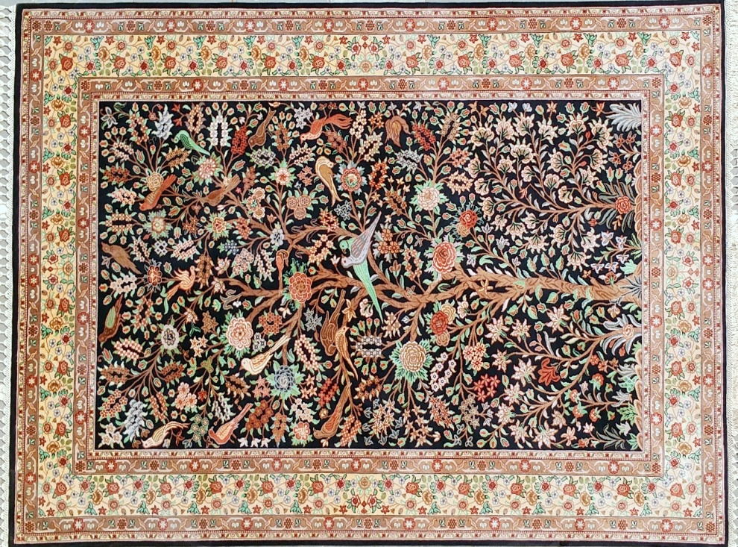
VILLAGE-02
BHAKTIYARI
TREE OF LIFE
VILLAGE-01

Slide 9
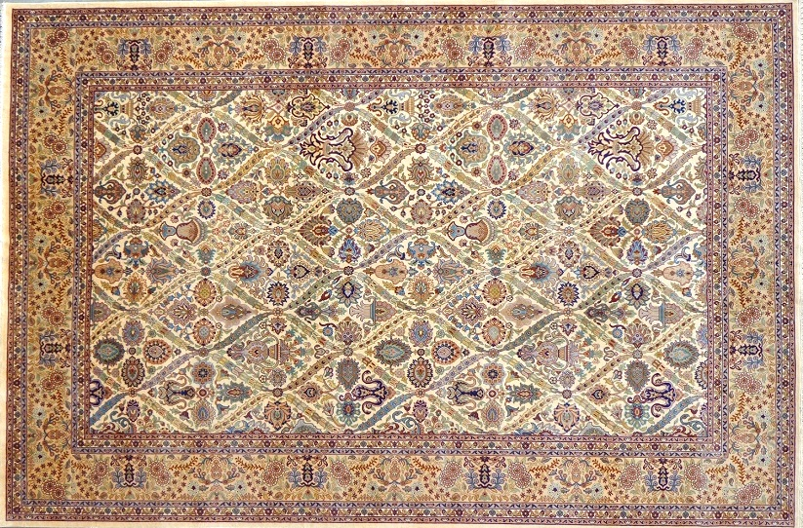
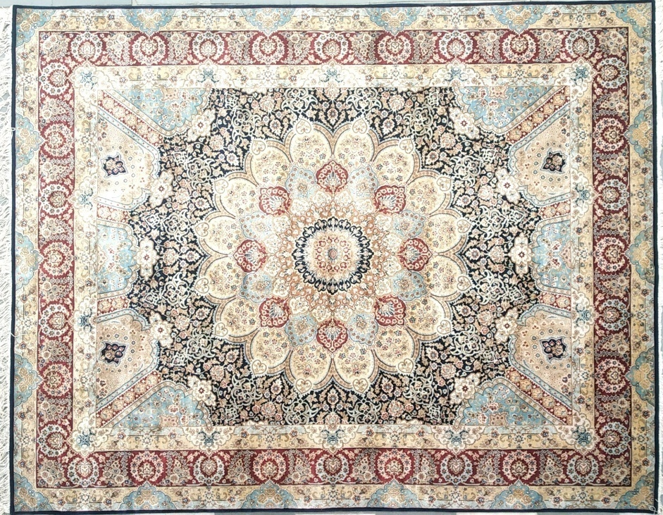
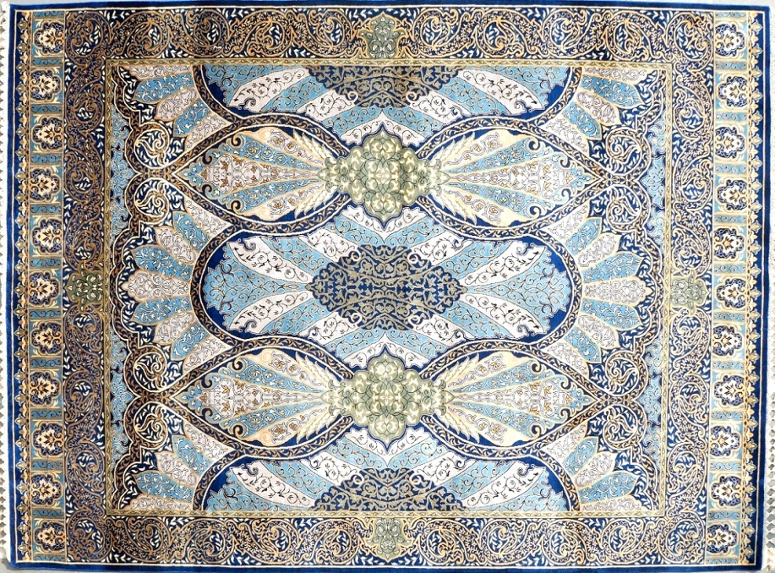
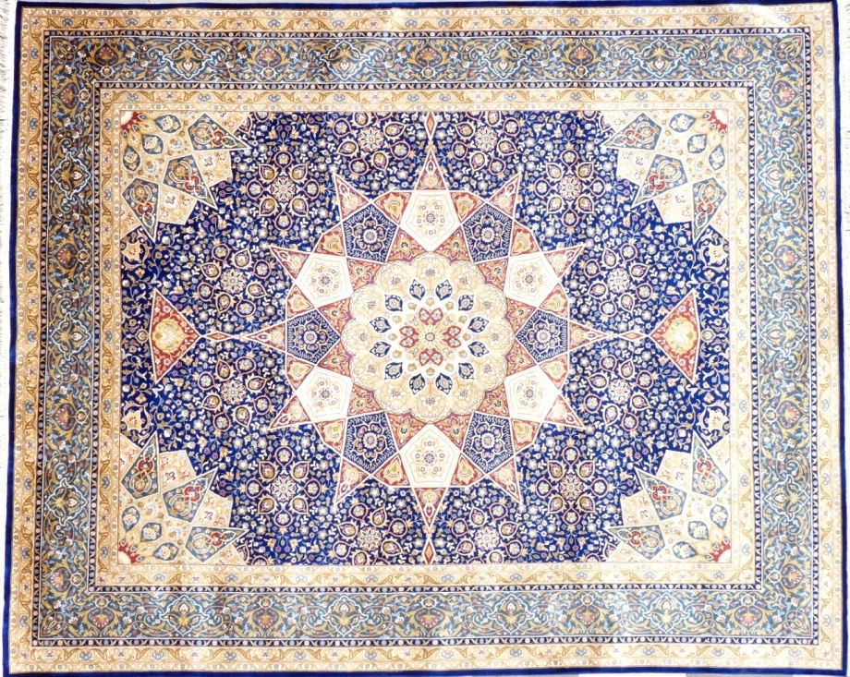
BHAKTIYARI
GUMBAS-05
CH-05
GUMBAD-03

Slide 10
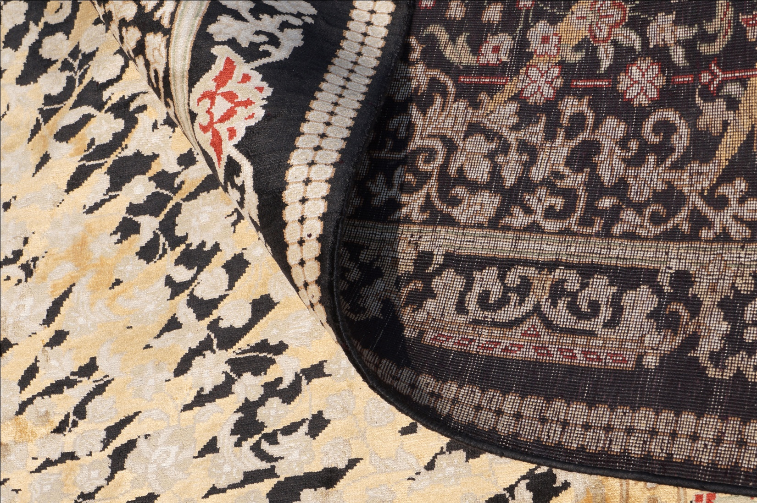

Slide 11
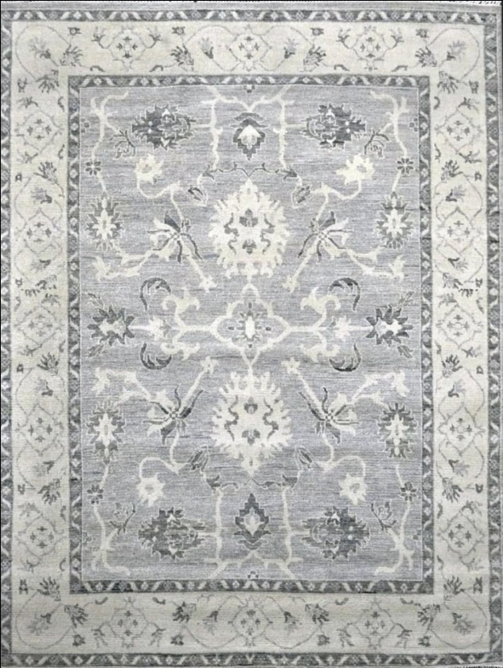
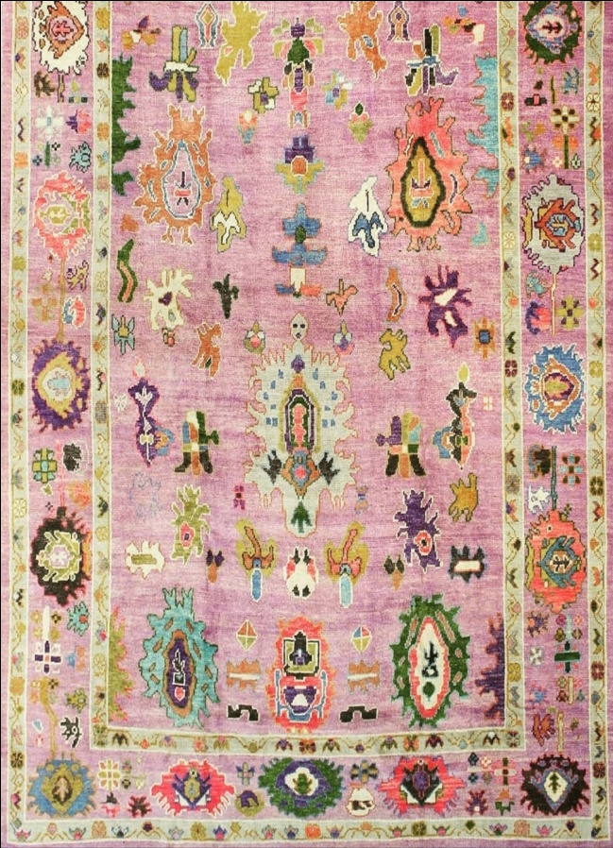
Trend : Mankind
LUCA
Construction Hand-Knotted
Material s 100% wool
Origin India
• Elegantly nuanced palette featuring
soothing gray and pink tones.
• Contemporary persion design
that are rendered with the softened
contours of an artisanal hand.
• Indian hand-knotted construction
in a luxurious wool blend.
14522 GREY
• All size available and custome size
also and all work done in house
campus only.
Size we make like ;
5.0x8.0,
6.0x9.0,
8.0x10.0,
9.0x12.0,
10.0x14.0,
12.0x15.0.
24522 PINK/MULTI

Slide 12
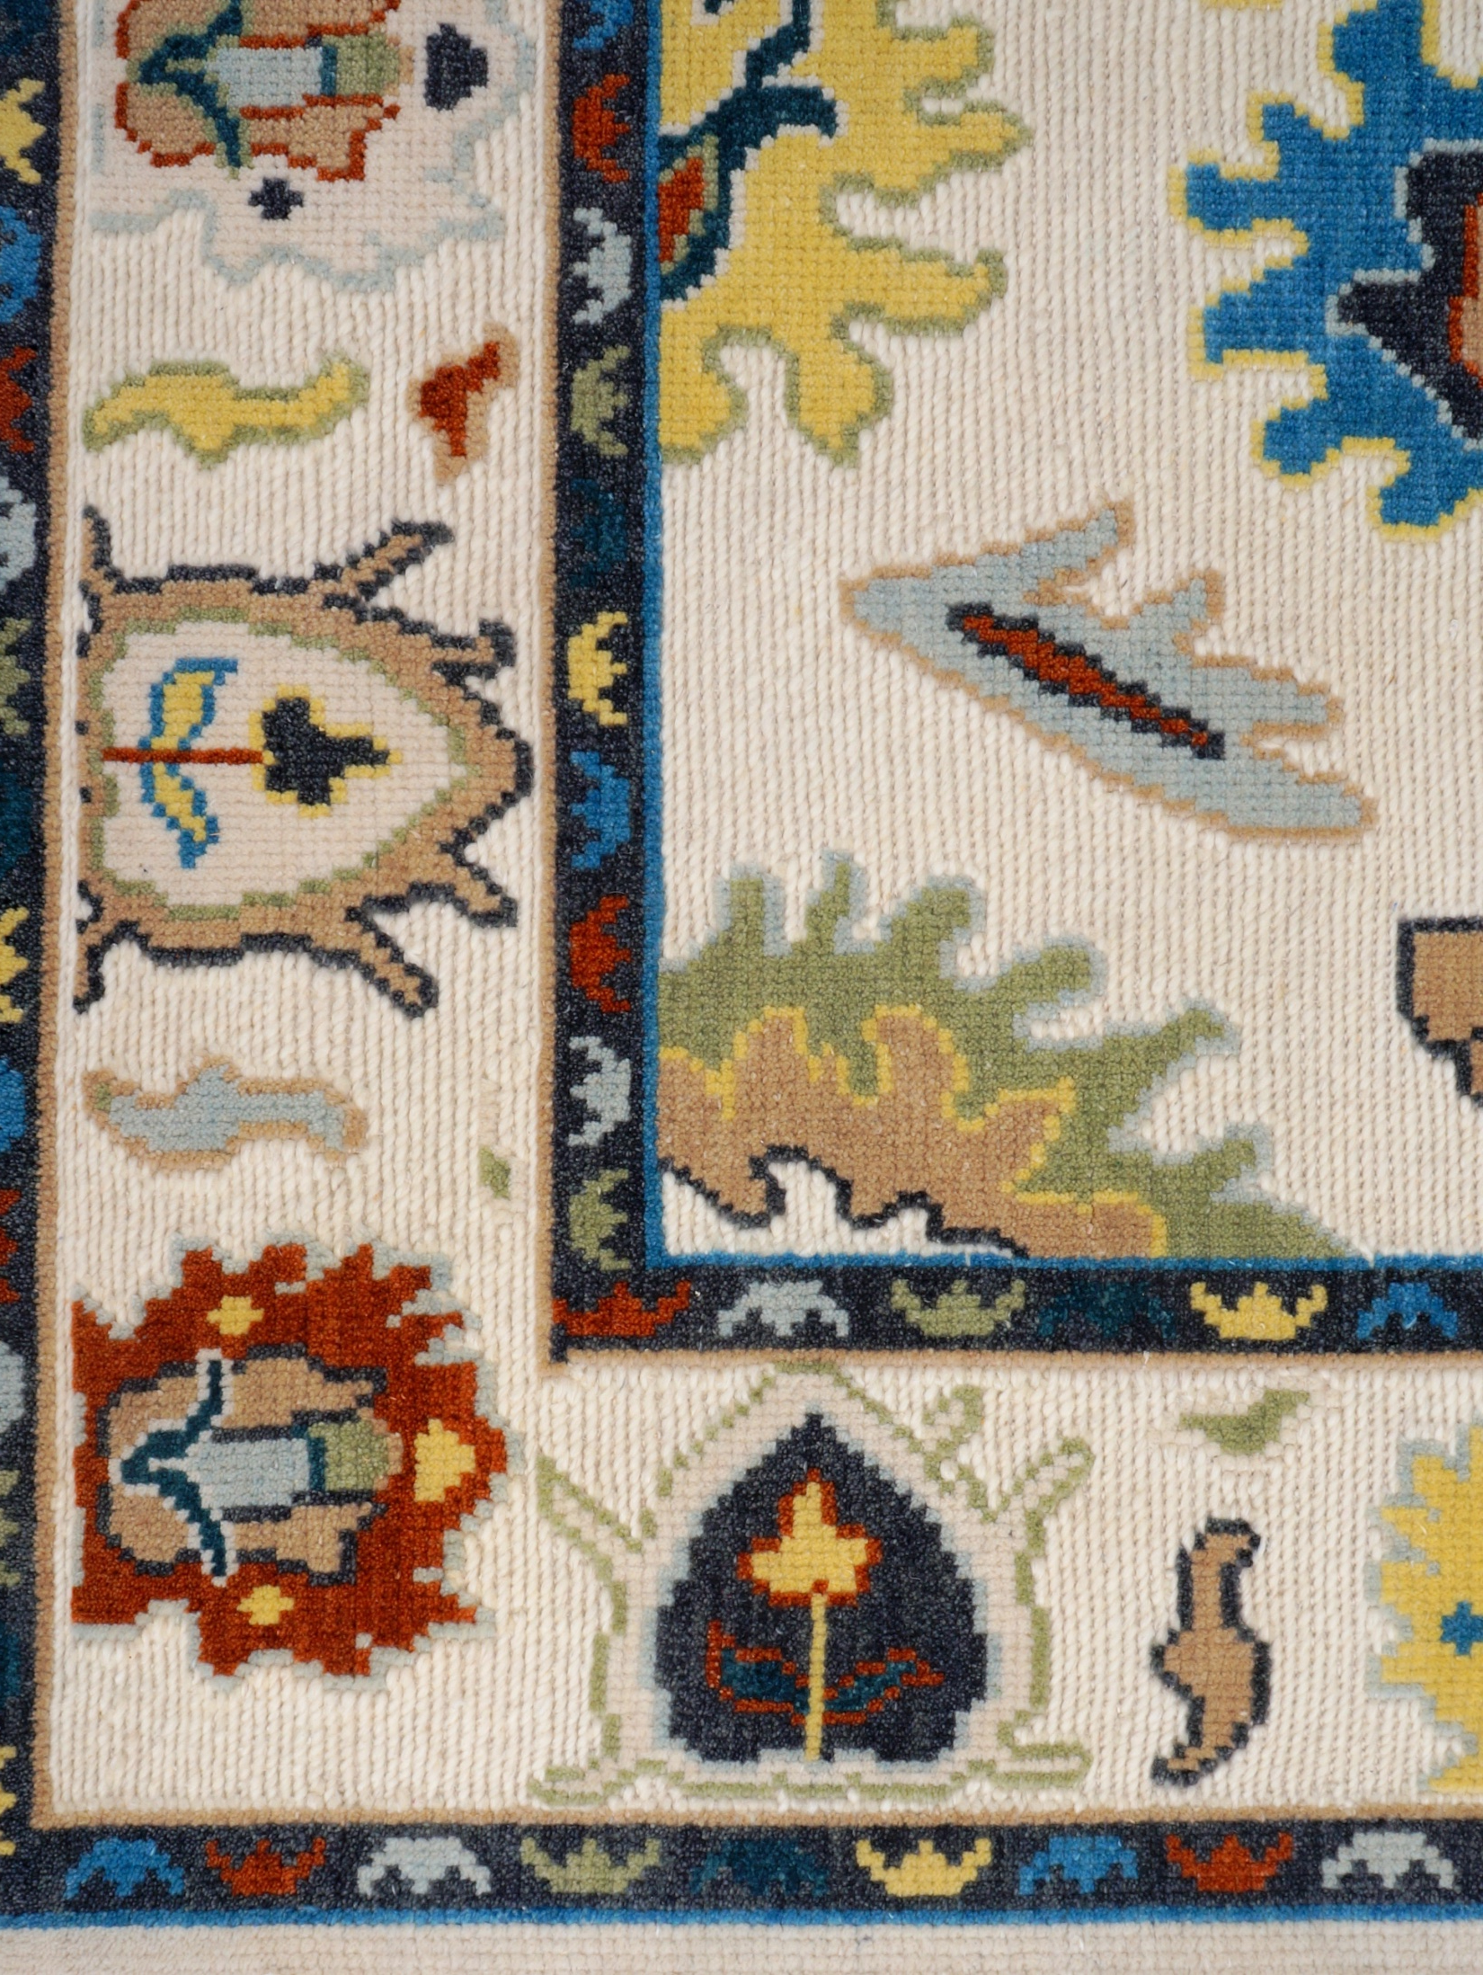
USHAK COLLECTION
34522 IVORY/MULTI

Slide 13
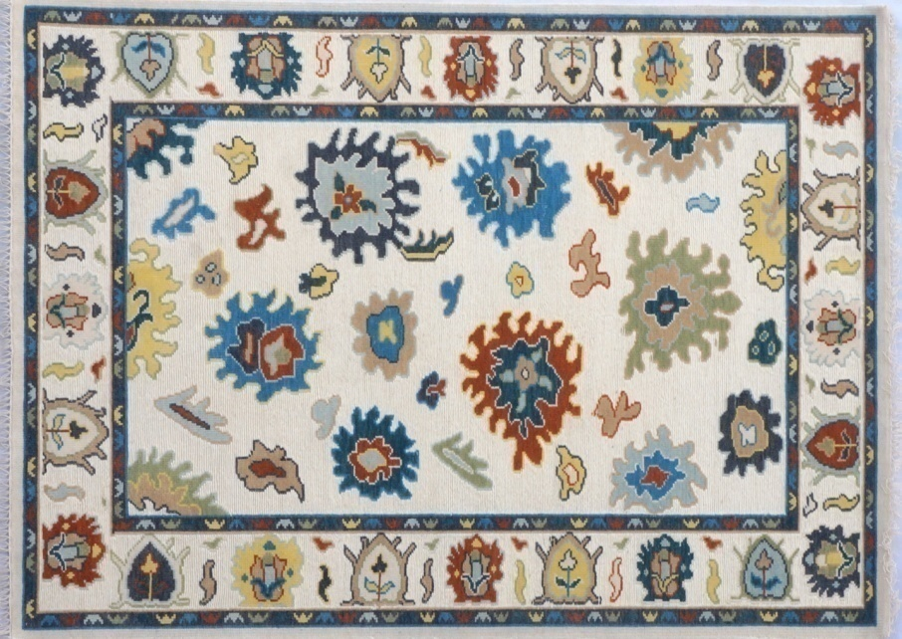
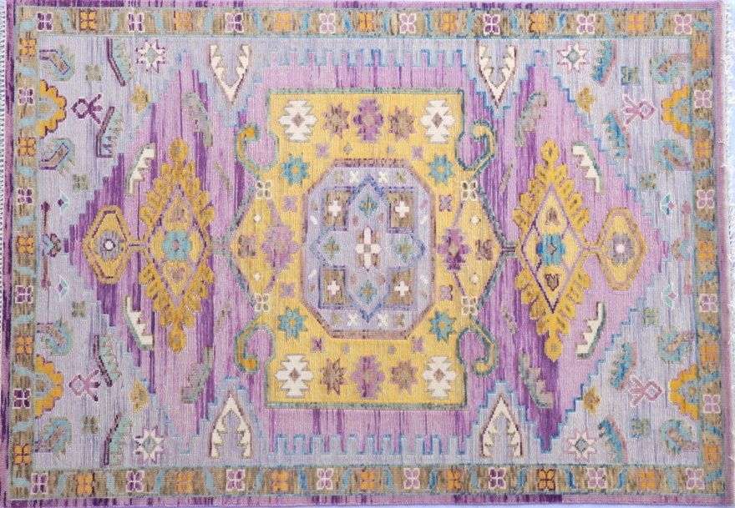
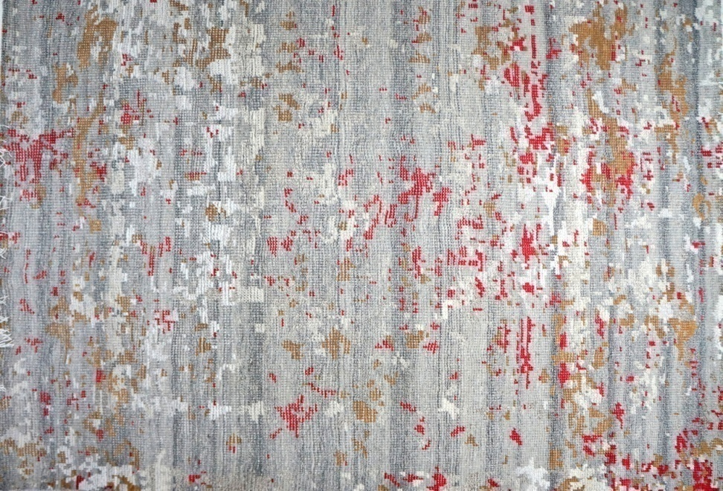
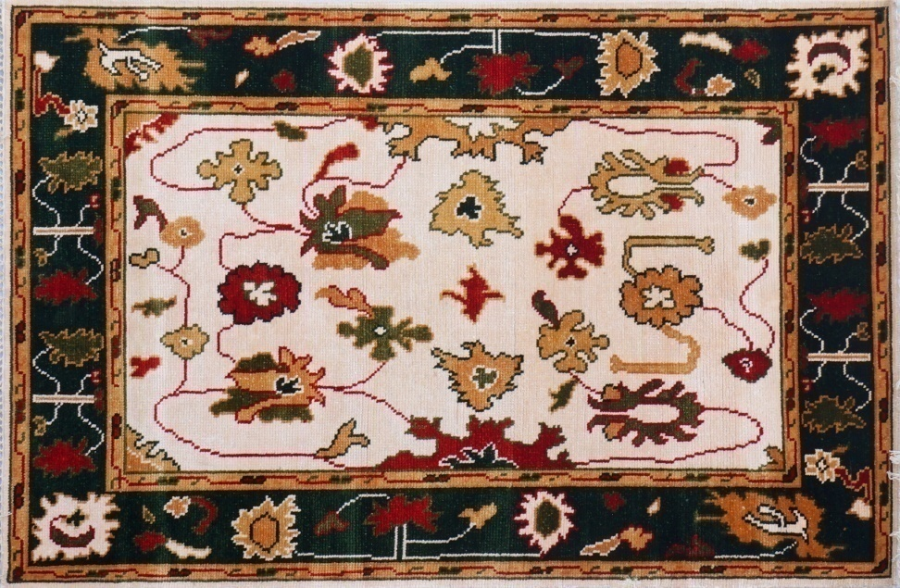
34522 IVORY/MULTI
44522 YELLOW/PINK
13020 GREY/MULTI
23020 IVORY/GREEN

Slide 14
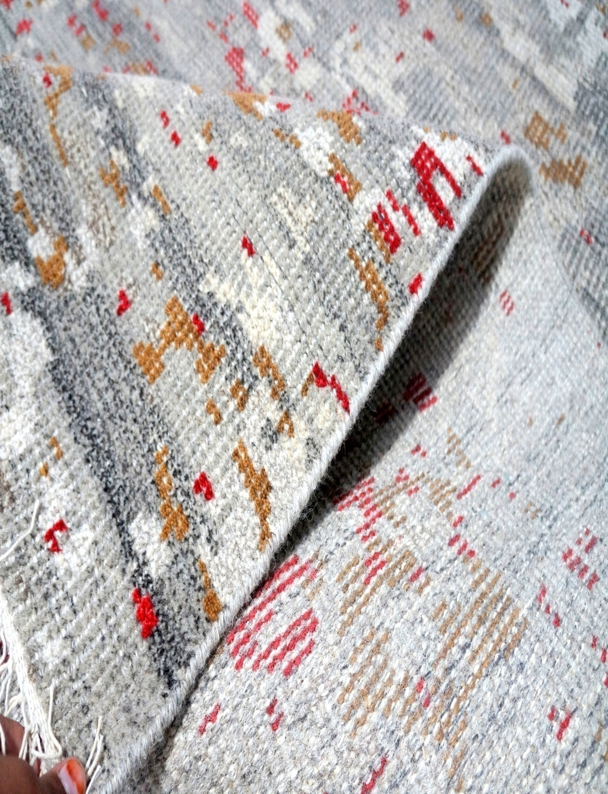
13020 GREY/MULTI

Slide 15
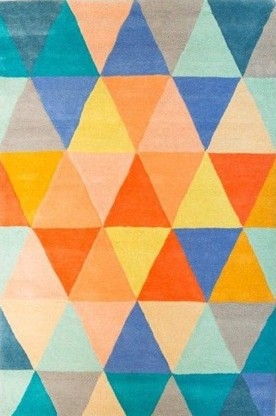
Trend : Mankind
GEOMRO
Construction Hand-Tufted
Materials 100% wool
Origin India
• Dyed neutral palette that
features natural shades ranging
from buttery cream to deep
dark colour.
• Bold geometric design expertly
styled and crafted with a triangle shape
aesthetic.
• Indian hand-tufted wool a dense, durable loop
that is generously accented with areas of loop and
cut pile.
HT1212 MULTI
• All size avaliable and custome also
like;
4.0x6.0,
5.0x8.0,
8.0x10.0,
9.0x12.0,
10.0x14.0 and so many.

Slide 16
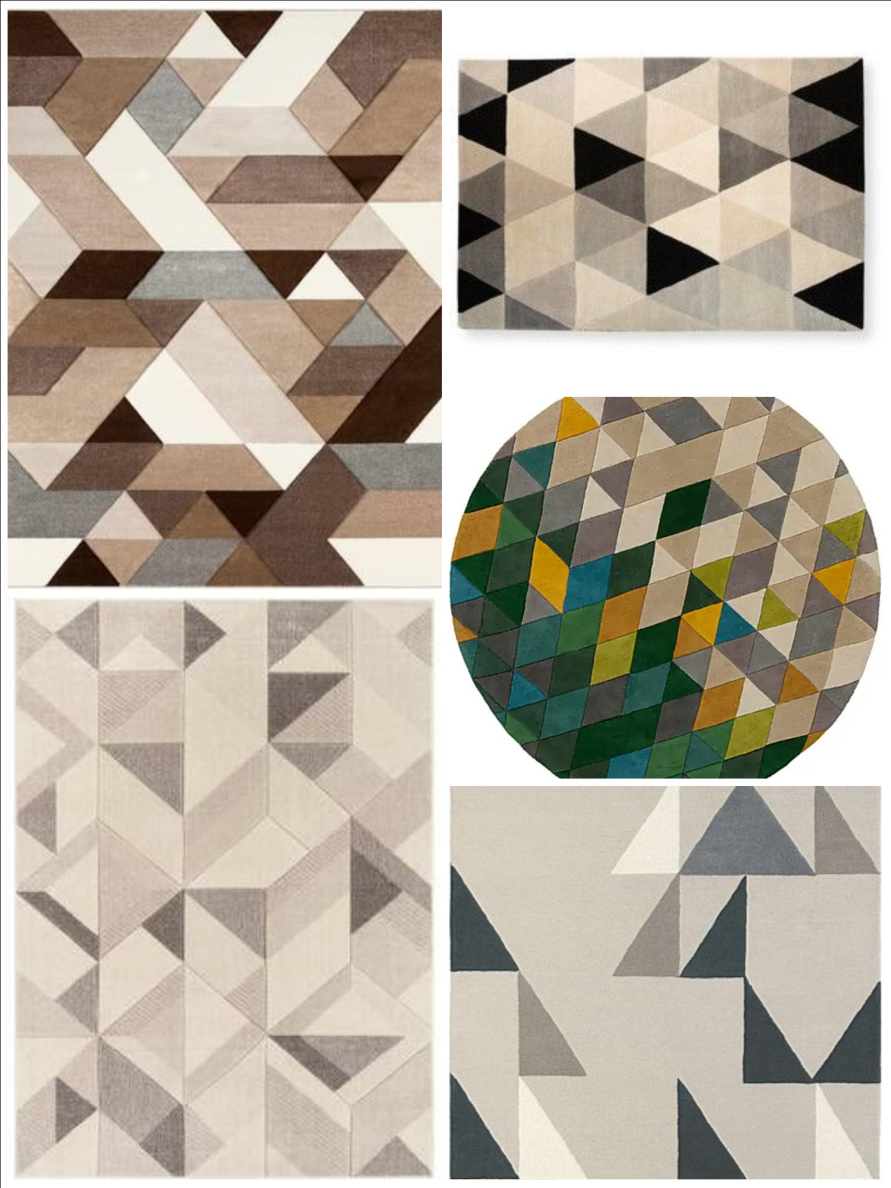
HT3212 BROWN/BLACK
HT2212 BROWN
HT5212 MULTI
HT4212 LT. BROWN
HT6212 PEECH

Slide 17
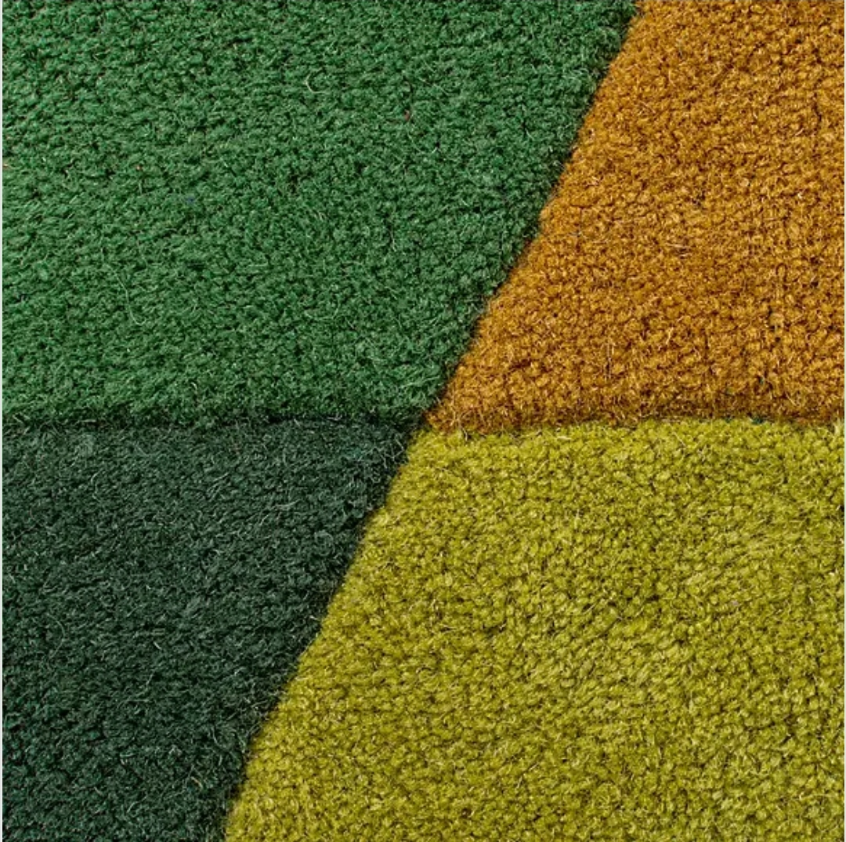
HT 5212 MULTI

Slide 18
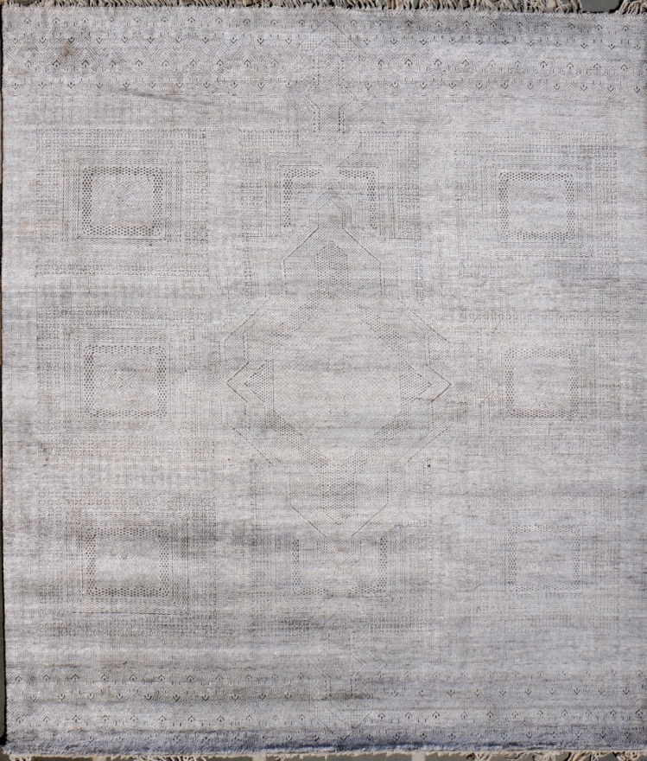
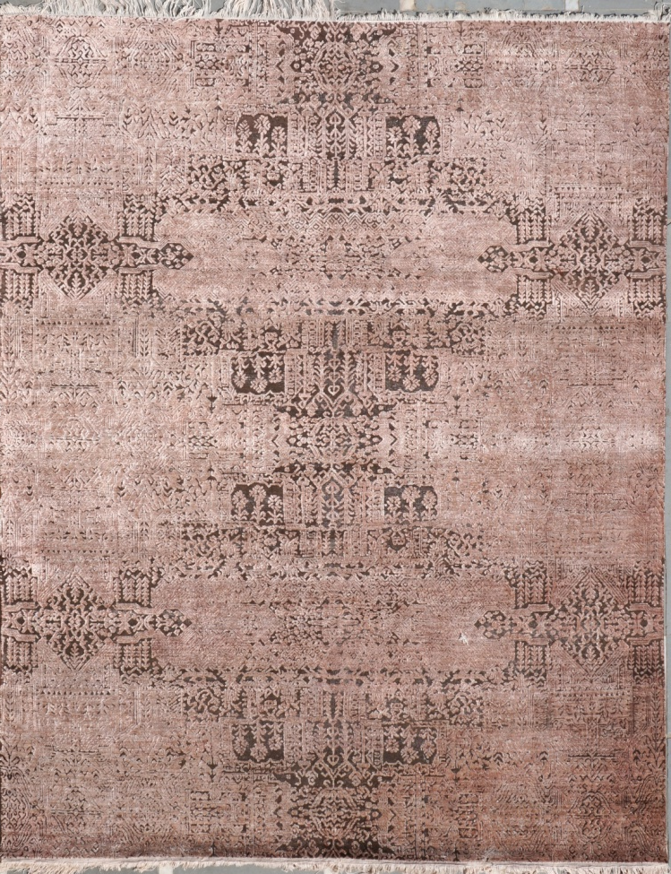
Trend : Mankind
CARLOS
Construction Hand-Knotted
Material s Wool & Bamboo
Origin India
• Dyed neutral pelette that features
shades and burn wool with fire to
show more elegent the design.
• A two tone carpet design show the
expertly styled and burned wool
and bamboo silkin modern style.
TTO-11 LT. GREY
• Indian hand-knotted wool and
bamboo a dense, durable that is
generously accented with areas of
high low pattern.
• All size available and custome
size also and all work done in
house campus only.
Size we make like ;
5.0x8.0,6.0x9.0,
8.0x10.0,9.0x12.0,
10.0x14.0,12.0x15.0
TTO-10 BROWN

Slide 19
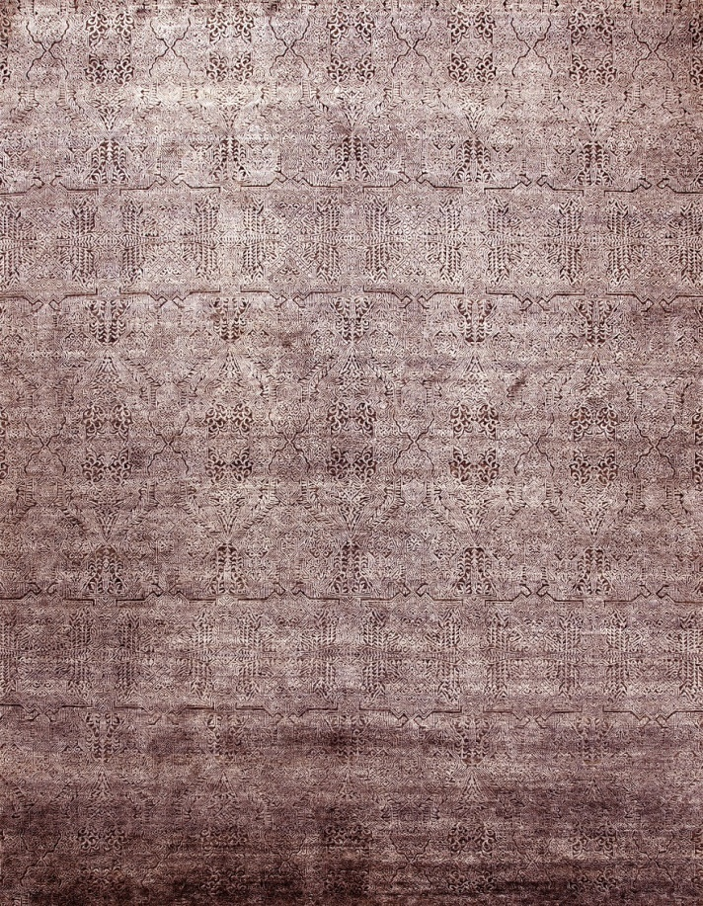
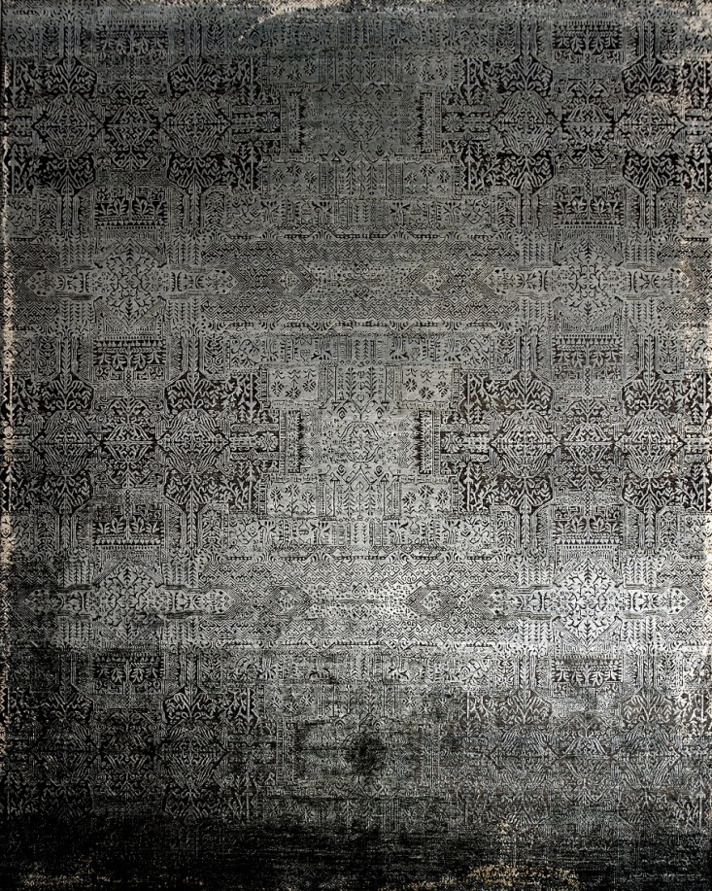
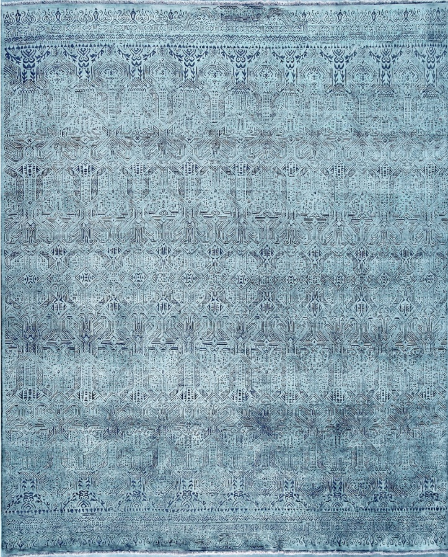
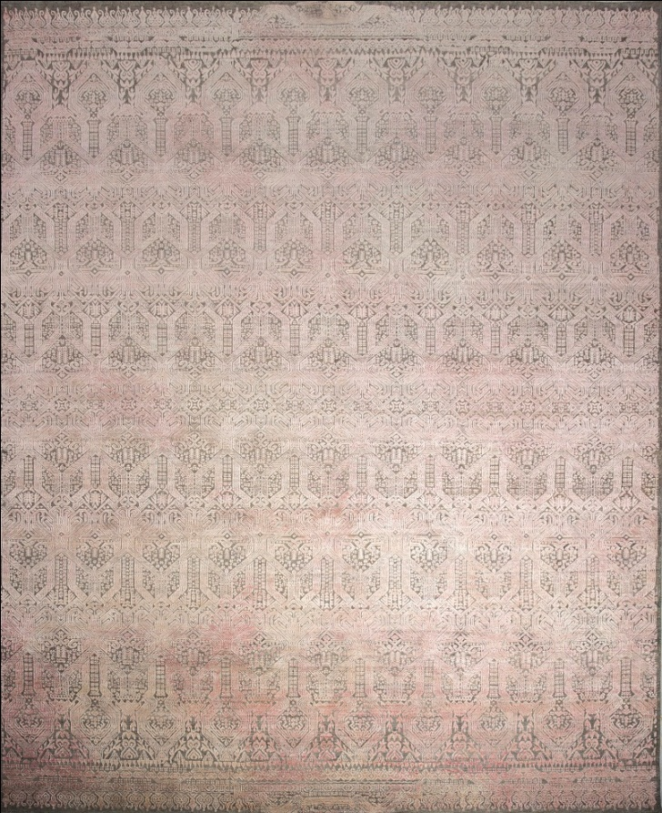
TTO-014 D. PINK
TTO-013 BLACK
TTO-015 BLUE
TTO-012 PINK

Slide 20
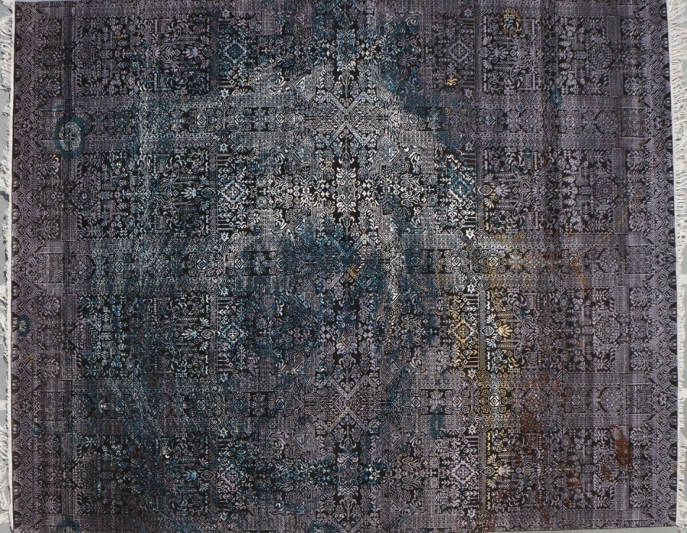
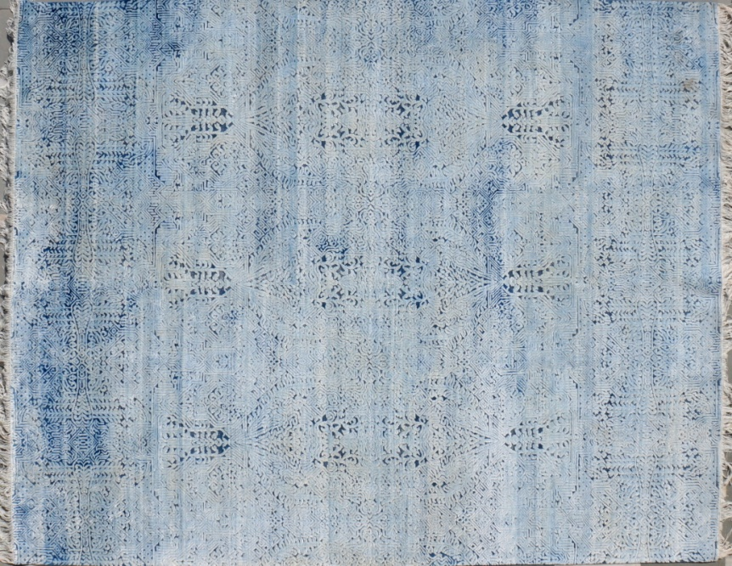
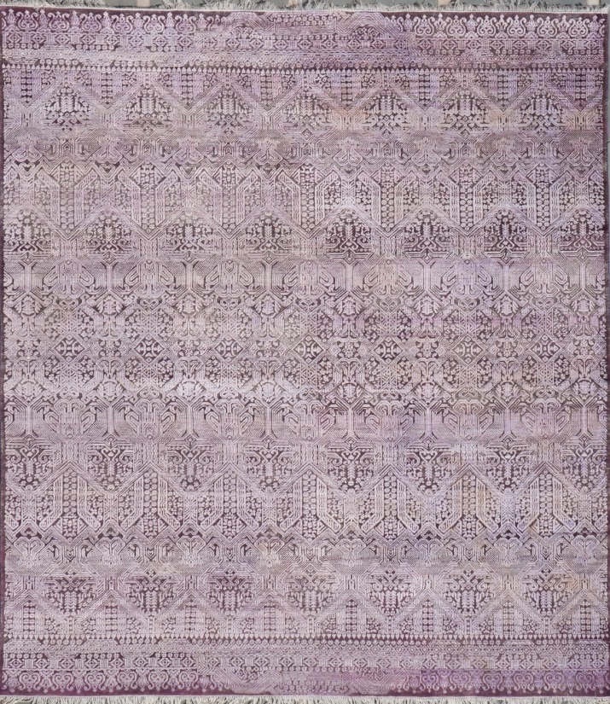
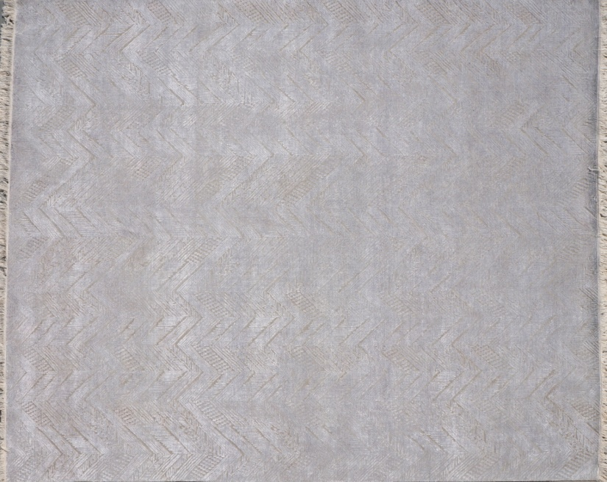
TTO-05 CHARCOAL
TTO-08 BLUE
TTO-01 LT.MERGENDA
TTO-03 SILVER

Slide 21
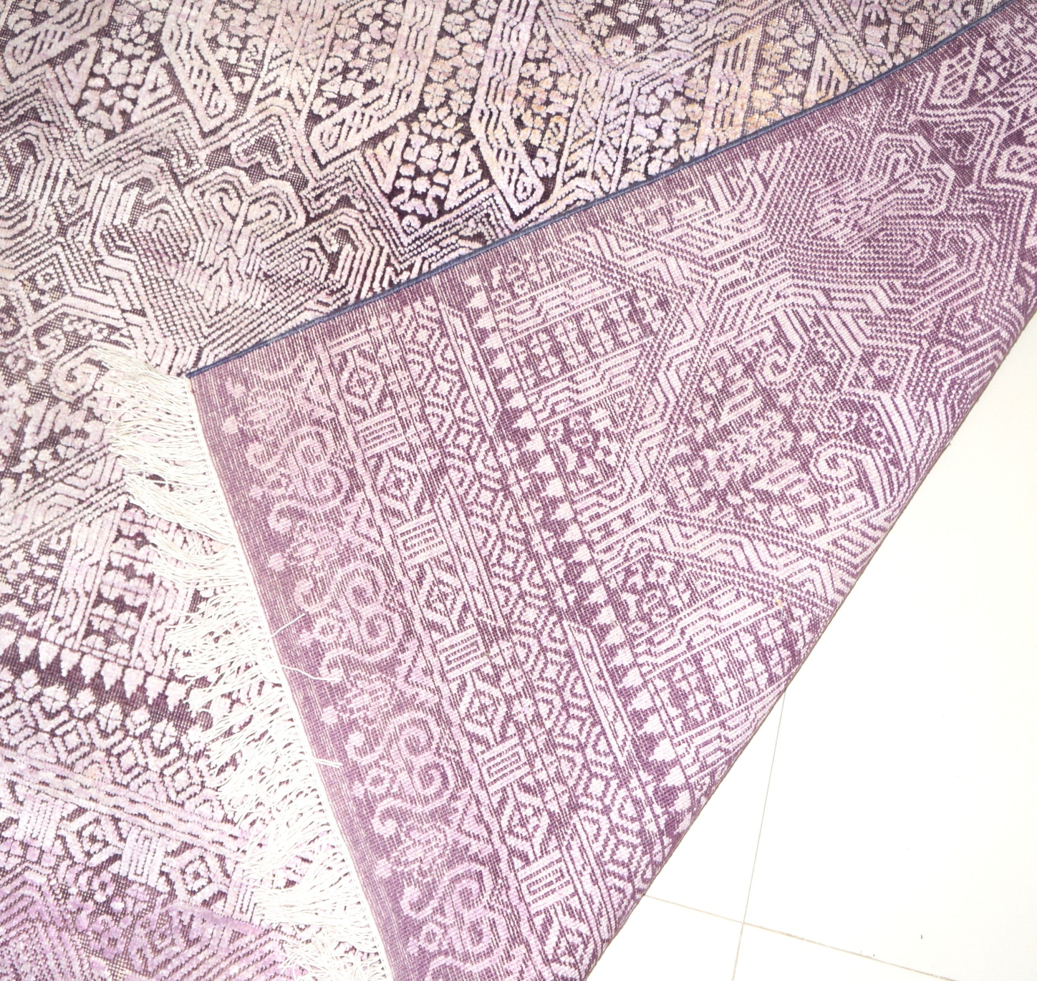

Slide 22
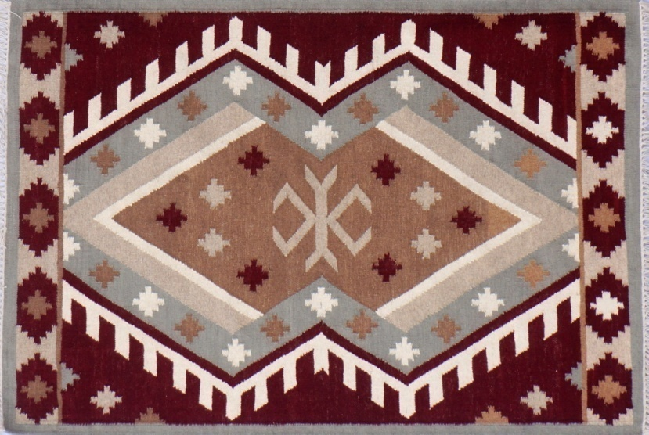
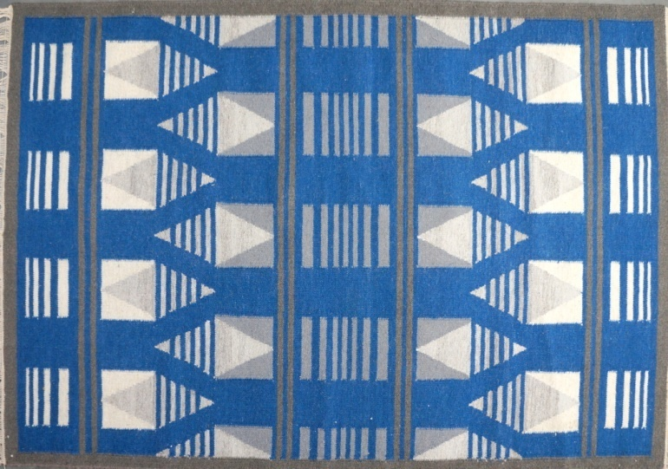
Trend : Mankind
MARCO
Construction Flatweave
Materials 100% Wool
Origin India
• Dyed neutral pelette
that features dark shade of flatweave.
• A gorgeous palattes, both rich and
subtle, creates to flatweave.
FW0001
• A luxurious, yet easy-care woven base
of wool and cotton , finished with
streching and cleaning.
• All custom size and normal size available
FW0002

Slide 23
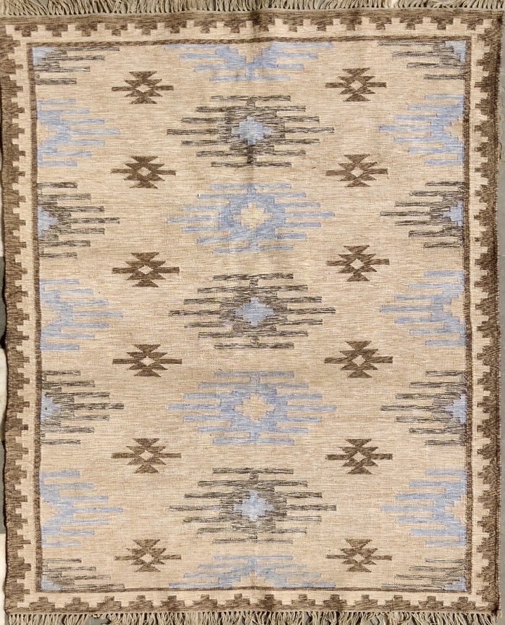
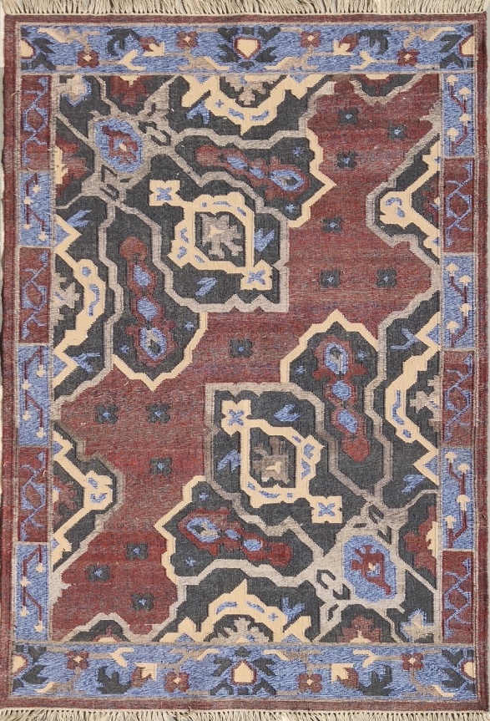
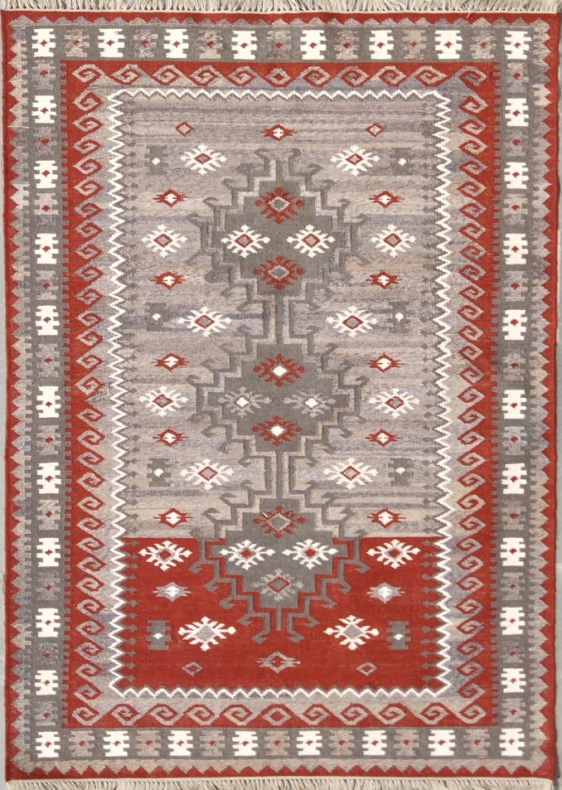
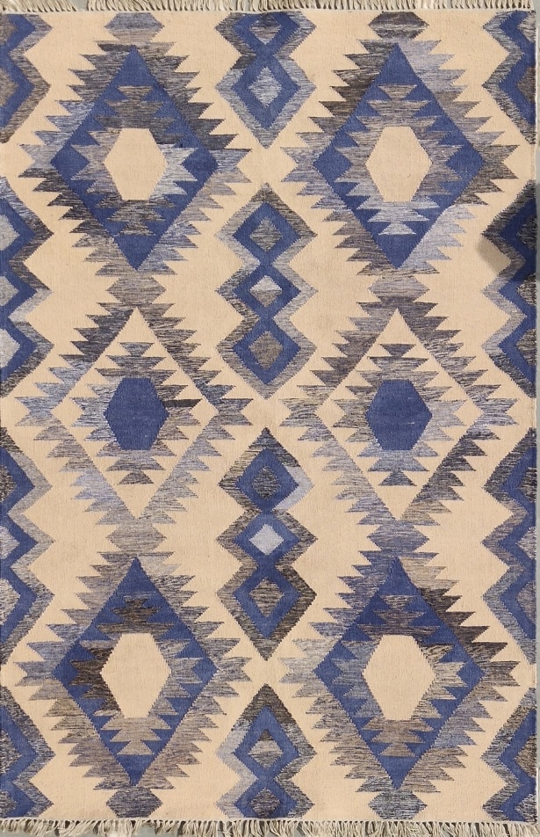
FW0003
FW0004
FW0005
FW0006

Slide 24




FW0007
FW0008
FW0009
FW0010

Slide 25


Slide 26


Slide 27


Trend : Mankind
KAMBAL
Construction Hand-Tufted
Materials Wool/Blanket
Origin India
• Dyed neutral palette and natural wool that
features natural shades ranging
from buttery cream to deep
dark colour and texture colour.
• Persion and modern design expertly
styled and crafted and zero pile with a
triangle shape aesthetic.
• Indian hand-tufted wool a dense, durable
and zero loop that is generously accented
with areas of loop and cut pile.
HT0001
HT0002

Slide 28




HT0003
HT0004
HT0005
HT0006

Slide 29




HT0007
HT0008
HT0009
HT0010

Slide 30


Slide 31



Slide 32

SHOWROOMS
VISIT US :
MIRZAPUR SHOWROOM
KABIR CARPET INTERNATIONAL,
VINDHAYACHAL ROAD,
MIRZAPUR, UTTAR PRADESH,
INDIA 231307
CONTACT-+91 9336570525, 8299401959
EMAIL- INFO@KABIRCARPETINTERNATIONAL.COM
yusufmzp@gmail.com, taufiquealam006@gmail.com

Slide 33

KABIR CARPET INTERNATIONAL
SINCE|RUGS|1970

